Slide 1
Procedural Generation Study
By: Skyler Gentner

Slide 2
Objectives of Study
Generate Terrain using Perlin Noise
Generate Terrain using Worley Noise
Generate Terrain using Fractal Noise
Determine which type of noise stated above generates the most realistic looking terrain

Slide 3
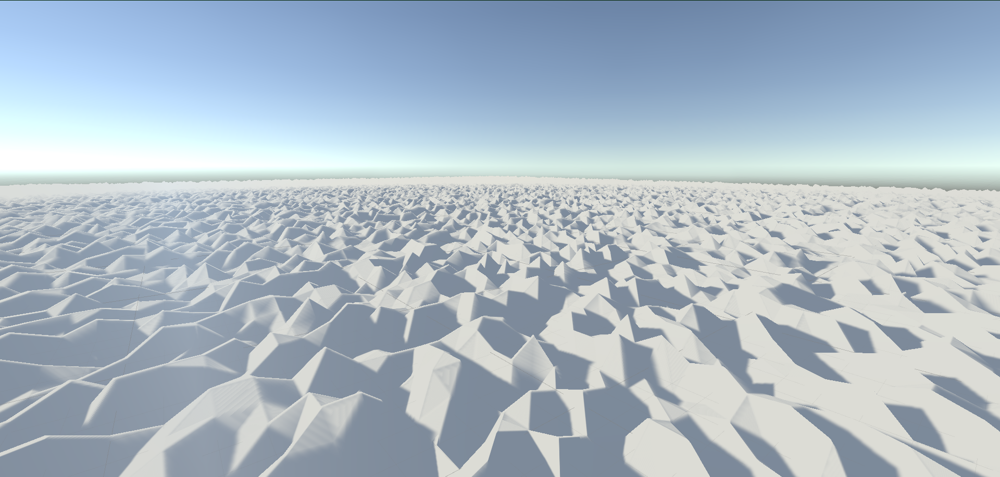
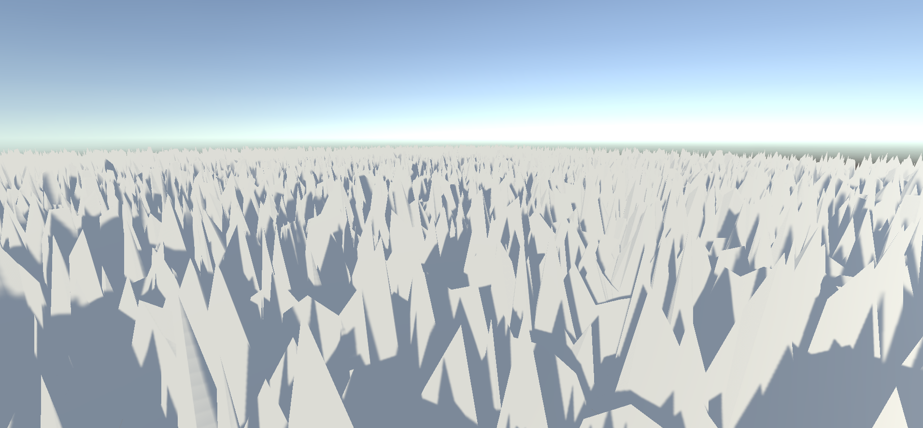
Perlin Noise
Scale = 10 Perlin Noise Terrain
Scale = 100 Perlin Noise Terrain

Slide 4
Perlin Noise
Pros
With lower scales the terrain almost looks like rolling hills or like small slopes
Very easy implementation
Very fast generation time
Even though I wrote a Perlin noise function out, Unity and many other math libraries will have a Perlin noise function already implemented
Cons
If the scale gets too high the terrain will be spikey and could be unusable (The case with scale equals 100 in the previous slide)

Slide 5
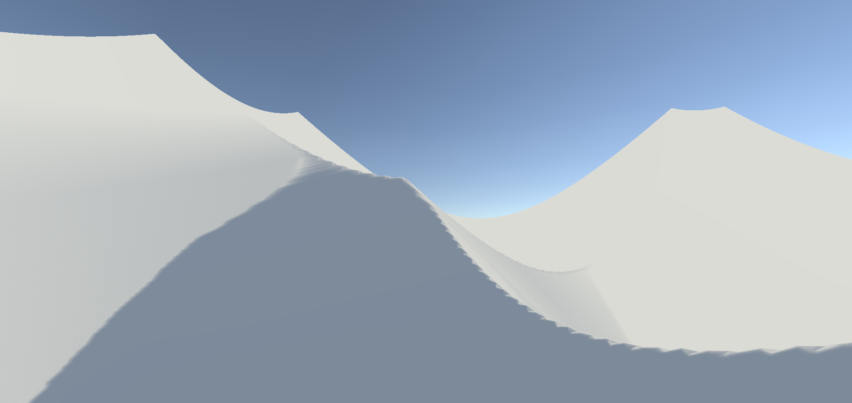
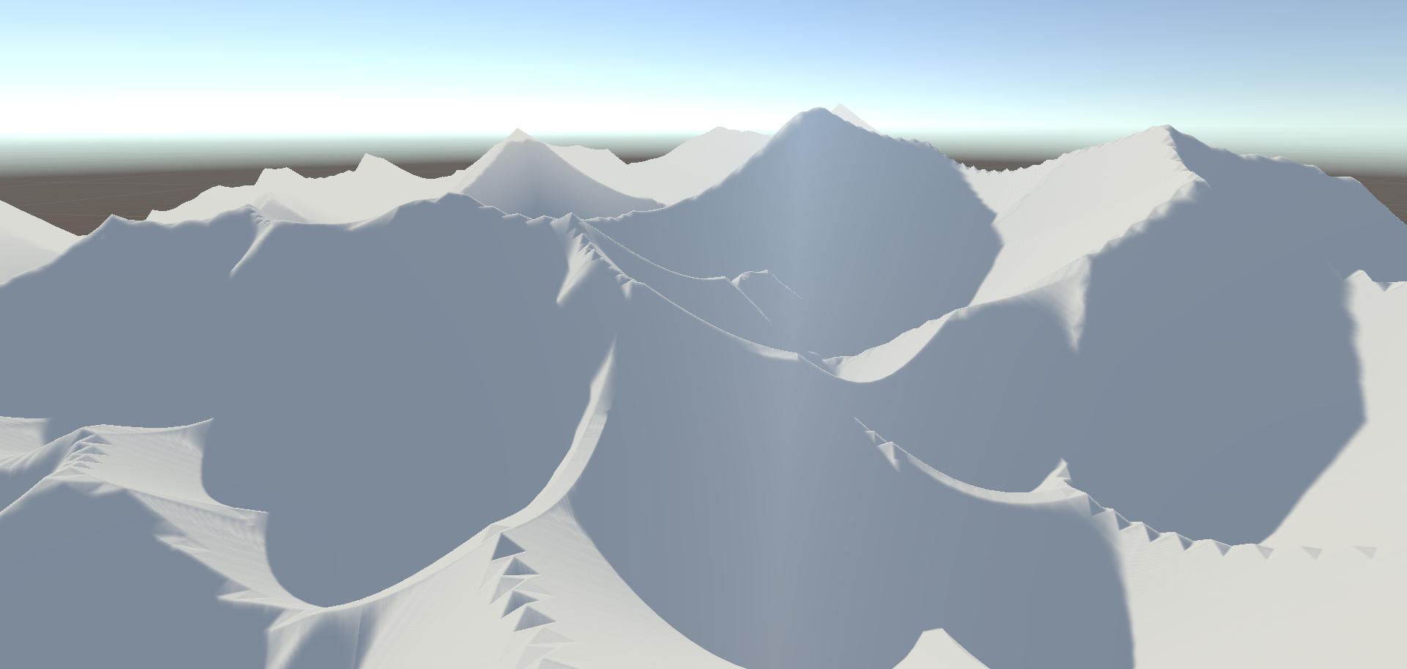
Worley Noise
# of Points = 5 Worley Noise Terrain
# of Points = 175 Worley Noise Terrain

Slide 6
Worley Noise
Pros
With a high number of points the terrain looks like a mountain range
Moderate difficulty for the implementation
Very fast generation time
Cons
If the number of points for the terrain are set too low the terrain looks like bowls since the height it based off of its distance to the closest random point.

Slide 7
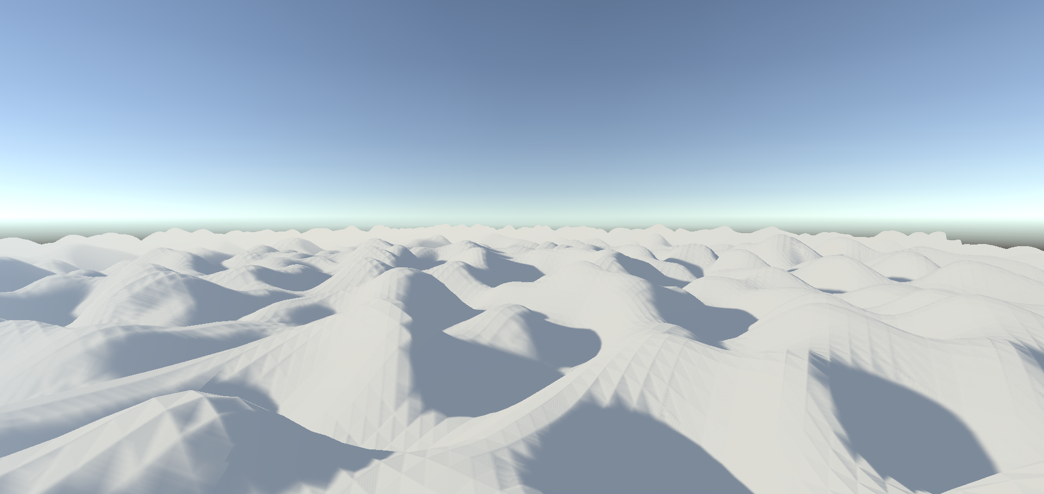
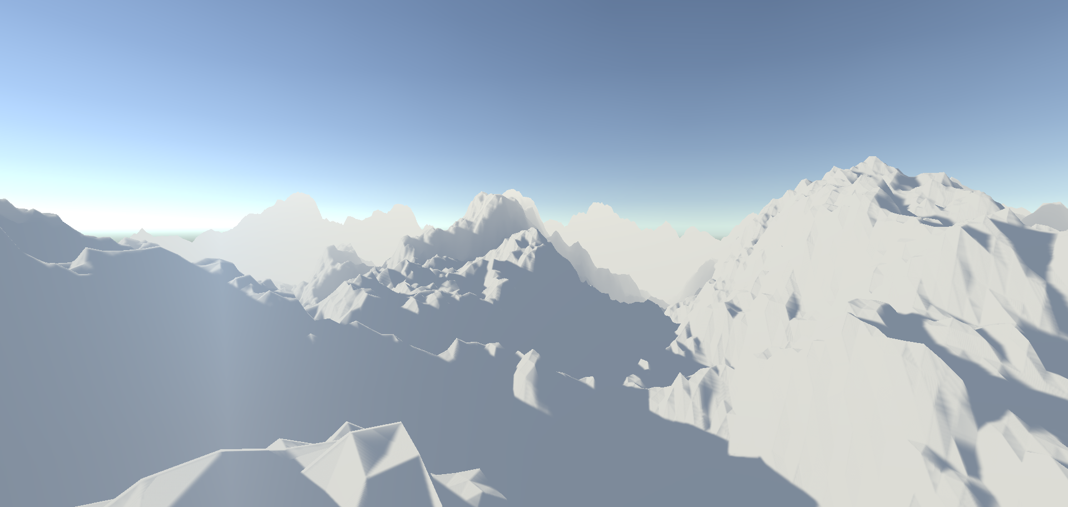
Fractal Perlin Noise
Scale = 10
Octaves = 3
Lacunarity = 1
Persistence = 0.05
Amplitude = 1
Scale = 50
Octaves = 10
Lacunarity = 3
Persistence = 0.35
Amplitude = 1

Slide 8
Fractal Perlin Noise
Pros
With higher inputs the terrain looks like a detailed mountain range
Moderate generation time
Easy difficulty for the implementation
Cons
With higher inputs the generation of the terrain could take longer
The lower and lower you go with the inputs the flatter and more boring it gets

Slide 9
Conclusion
If I had to choose just one type of noise for terrain generation, I would choose the Fractal Perlin Noise since it doesn’t take much computation to get really good looking terrain
If I had the option though I would use all of the different generation types
I would use Perlin Noise for things like waves in water since it is similar to the effect of sine waves but has some variance.
I would use Worley noise for mountain ranges if it didn’t need much detail, i.e. it is far from the player
I would use Fractal Perlin Noise for any terrain that is close to the player and needs detail since it is a costlier function to run

